Slide 1
Parents’ Meeting
Introduction to Read Write Inc.
Notes:
Approximately 20 minutes is needed for this session.
Notes are provided to help you lead the presentation.
Notes in italics are for your attention only.
This bitesize parent session is designed as an introduction to Read Write Inc when you first implement the programme in your school and for parents of new YR children each September.
Use the other bitesize parent PPTs throughout the year to discuss and practise how they can help their child at home based on the child’s group.
Notes are provided to help you lead the presentation.
Notes in italics are for your attention only.
Provide copies of ‘Reading at Home Booklet 1 or 2’ from Oxford Owl.
Booklet 1 is sound groups and Ditty/ Red Groups and Booklet 2 for Green – Grey Storybooks.

Slide 2
Reading changes everything
Teach a child to read and keep that child reading and we will change everything.
And I mean everything.
Jeanette Winterson
Notes:
Read quote.
This is what we do in our school.
Research shows that children who learn to read quickly go on to succeed in school and in life.
Today we want to help you understand how your child is learning to read with phonics – specifically ‘Read Write Inc.’ Phonics.
Share success of the programme over the past 8 years.
ANNIE

Slide 3
Read Write Inc. Phonics
Children learning to read in YR– Y2
Older children who need to ‘catch up’
Taught in groups based on their stage of reading
Notes:
Who Is Read Write Inc Phonics for?
(Click) Phonics is for children in Reception, Y1 and Y2 who are learning to read.
Phonics is also for children in Y3 and Y4 who haven’t met the KS1 reading expectations who need support to catch up.
Each half-term, we assess and group our children based on their stage of reading not age of reading. This means all children practise reading at the right level.
KATE

Slide 4
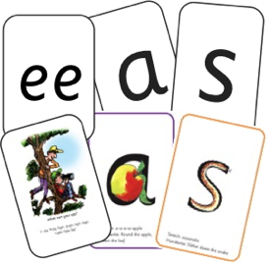
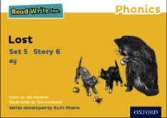


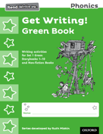






Read Write Inc. Phonics daily lessons
Notes:
What Read Write Inc. does is simple - we teach sounds (click), children practise reading and spelling words containing these sounds (click), then we give children decodable books (click) containing sounds and words they can read.
They read each Storybook three times at school and again with you at home.
On each reading, children’s fluency increases and the more they can focus on what the story is about.
Children also learn to spell the words they have been reading and develop their ideas into sentences so that they can write about the Storybooks they read.
Alongside this we read stories to children: (click) stories they cannot yet read for themselves
Our aim is for children to finish the RWI Phonics programme quickly so they can start reading these books for themselves.
KATE

Slide 5
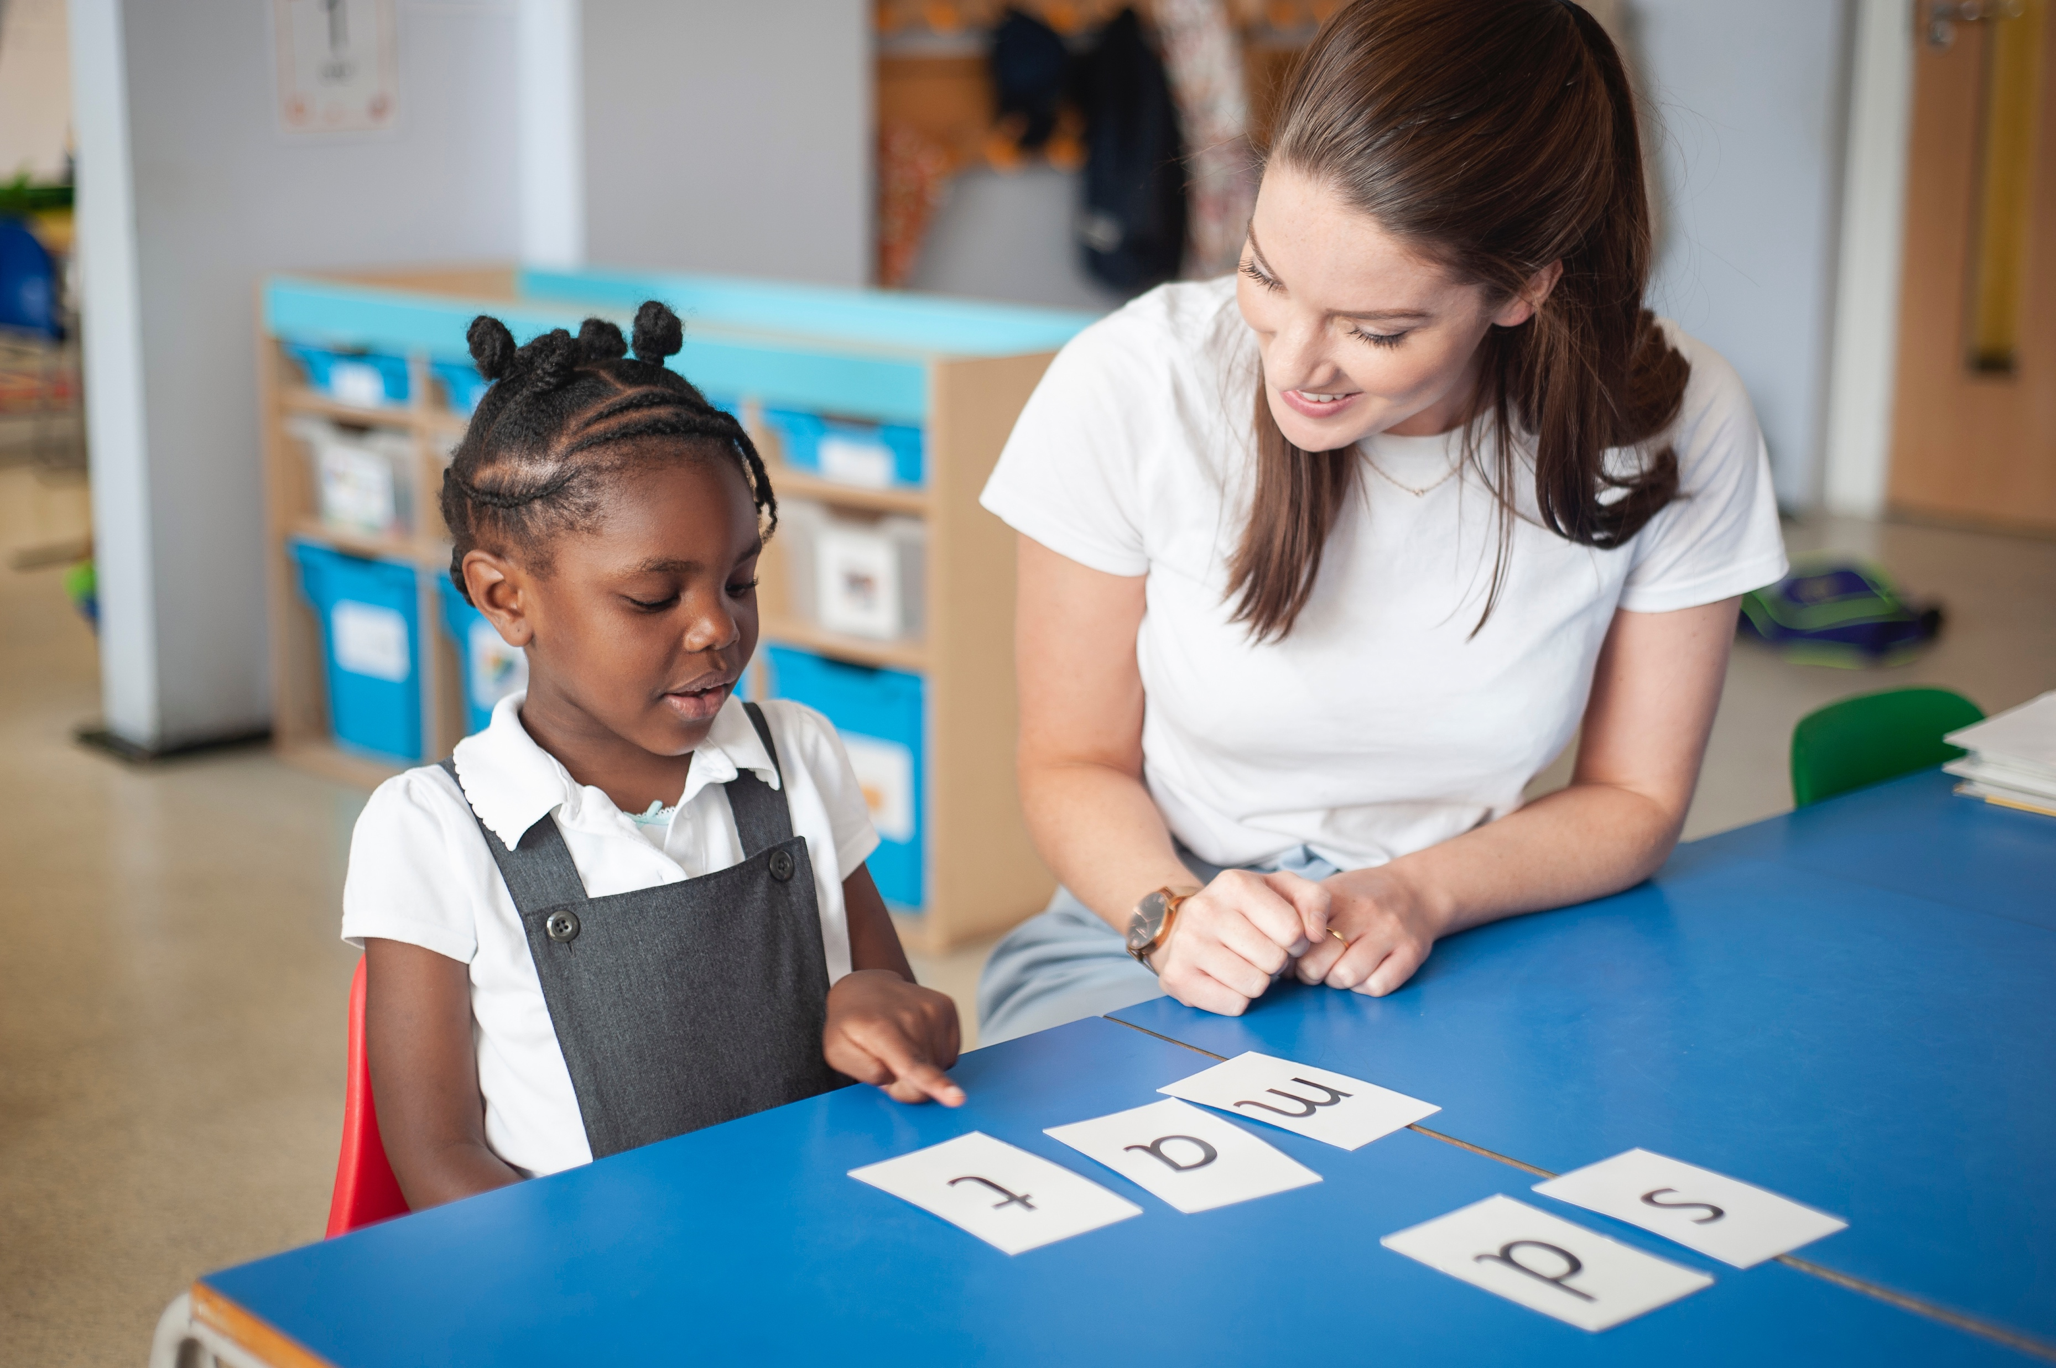
One-to-one tutoring – ‘keep up, not catch up!’
Notes:
We want to make sure every child learns to read in our school.
Some children need extra practice when learning to read so we teach these children one-to-one for ten minutes every day – on top of their group lesson.
Our aim is that they ‘keep up’ from the beginning and don’t need ‘catch up’ later on.
KATE

Slide 6
What is phonics?
Sounds
Graphemes
Notes:
All words are made up of individual sounds. These sounds are merged together to form words.
e.g. in ‘mat’ we have the sounds ‘m’, ‘a’, ‘t’, ship – ‘sh’, ‘i’, ‘p’.
Click A grapheme is another name for the letters we use to write the sound. The spelling of that sound on the page.
Phonics is the method of teaching reading through the identification of sounds and graphemes.
The new National Curriculum ensures that all children are taught Phonics systematically. This gives your children the tools to read any word.
LAUREN

Slide 7
English alphabetic code
44 sounds
26 letters
Over 150+ graphemes (letter combinations)
One of the most complex alphabetic codes in the world.
Notes:
We use 44 sounds to make all the words in the English language.
This means we’ve got a problem.
We’ve got 44 sounds and only 26 letters.
The 26 letters work singly, in pairs and sometimes in threes to represent one sound.
We have to group letters together to write some sounds e.g. ‘igh’, ‘air’.
In English we have more than 150 ways to represent 44 sounds, using the 26 letters in the alphabet.
Click
This makes our language one of the most complex in the world!
LAUREN

Slide 8
Speed Sounds Set 1 and Set 2
Notes:
Using RWI, we make learning to read easy for children because we start by teaching them just one way of reading and writing every sound. Here they are on the Simple Speed Sounds chart we use in class.
We teach Set 1 sounds first - (sounds as far as a e i o u).
Children need to know sounds – not letter names – to read words.
LAUREN

Slide 9
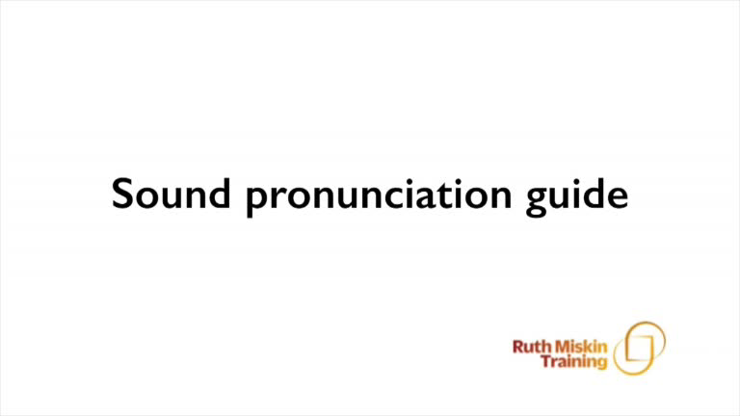
Pure Sounds (ruthmiskin.com)
Notes:
We teach using pure sounds.
We pronounce the sounds clearly, using pure sounds (‘m’ not’ muh’, ’s’ not ‘suh’, etc.) so that your child will be able to blend the sounds together to make words more easily.
You can watch this film of little Sylvie on the Ruth Miskin website to practise using pure sounds. Play a little bit of the video.
LAUREN

Slide 10
Speed Sounds Set 3
Notes:
Once children know one way of reading and writing every sound, they start to learn spellings for each sound they already know.
Point to the chart to show.
For example, they know ‘ay’ and now learn a-e and ai as other spellings for the same sound.
LAUREN

Slide 11
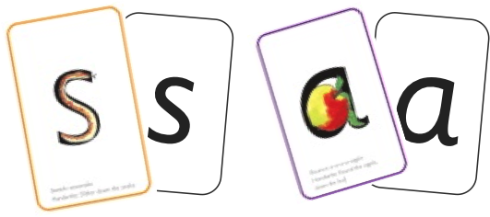
Sounds + blending = reading
+
Notes:
Alongside teaching children sounds, we teach them to blend sounds to read words e.g. s-a-t, sat.
We use Fred Talk to help children read.
LAUREN

Slide 12
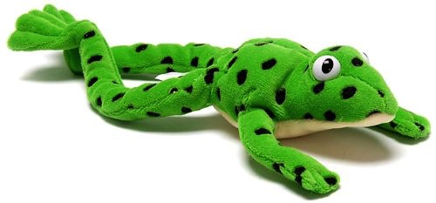
Fred
Notes:
Let me introduce you to Fred.
Fred can only speak in sounds. He says d-o-g, h-a-t etc.
Speaking like Fred helps children to understand that words are made up of sounds.
Fred helps children practise blending sounds together because he needs the children to say the words for him. Fred says d-o-g, children tell him the word is dog.
This is how we quickly teach all of our children to blend.
LAUREN

Slide 13

Teach spelling using Fred Fingers
Notes:
We use Fred Fingers to help children sound out words to spell easily.
It means they do not have to memorise lists of spelling words.
It is a tool so they will be able to spell any word. E.g. cat is pressed onto Fred Fingers as the sounds c-a-t. The children then know which letters to write to match the sounds.
LAUREN

Slide 14
‘Three with me, four at home’
Accuracy
Fluency
Comprehension
Read and enjoy at home
Notes:
When a child is ready to, they move onto reading Read Write Inc. storybooks.
In our school, children read each Read Write Inc. Storybook three times in class with their partner.
Re-reading the same book helps children to become confident readers. Each time they re-read, they build their fluency/speed and comprehension.
They love reading and want to read because they can read all of the words in the Storybook.
We set a focus for each re-read in school.
(Click) The first read focuses on reading every word accurately.
(Click) The second on reading the story more quickly.
(Click) The third read on comprehension - understanding what they read.
Then your child brings the same book home to read and enjoy with you again and again at home.
It’s ‘three with me, four at home.’
We do not send stories home the children cannot read because we always want them to be set up to succeed in their reading.
We want to make sure they enjoy reading so that they want to read.
The more they read, the faster progress they will make.
ABI

Slide 15





Which books will children bring home?
+
Notes:
In your child’s book bag, they will bring home:
the Storybook they have read in class to practise reading what they can already read.
A picture book (once a week) to share with you. You can read the story to them or they can retell the story by looking at the pictures. They are not expected to read the story themselves.
ABI

Slide 16
What can I do?
Use pure sounds, not letter names.
Encourage your child to practise the letter sound they have learnt at school each day.
Play ‘Fred Games’ with your child.
Use Fred Talk to read and spell words.
Listen to your child read their Read Write Inc. Storybook every day.
Read stories to your child every day.
Notes:
1. See sound pronounciation video on the Ruth Miskin Parents’ Page.
2. We will share with you a link to a virtual lesson (via Seesaw) each time your child learns a new letter sound. Share an example video using link below. Each letter sound has a handwriting phrase to help your child when writing/forming the letter on paper. This can be done in their home learning book).
3. Fred Games document will be uploaded onto Seesaw.
4. Why not purchase a Fred the Frog to have at home!
5. We will let you know when your child moves onto Read Write Inc. storybooks and how to use them at home.
6. Read, read and read some more! Every Wednesday, children choose a book from Reception’s lending library to bring home. Please read this to them, talk about what's happening in the story and ask them questions.
ABI

Slide 17
Online resources available
Ruth Miskin Parents’ Page:
https://www.ruthmiskin.com/en/find-out-more/parents/
Ruth Miskin Facebook:
https://www.facebook.com/miskin.education
For free Read Write Inc. Phonics eBooks, activities and advice, visit Oxford Owl for Home:
https://home.oxfordowl.co.uk/reading/reading-schemes-oxford-levels/read-write-inc-phonics-guide/
Notes:
LAUREN
Share first and third link.

Slide 18
Reading feeds the imagination, it expands
horizons and offers new and exciting ways of
seeing and making sense of our lives and of
the world around us.
Michael Morpurgo
Notes:
Remember that all parents have the power to change outcomes for their children.
ANNIE

Slide 19
Any other questions
Q&A
Notes:
Explain that we are available for a short to answer any questions you have. The FAQ’s document will also be uploaded to the Reception page of the school website and Seesaw.
Time to browse classroom and home learning resources.

