Slide 1
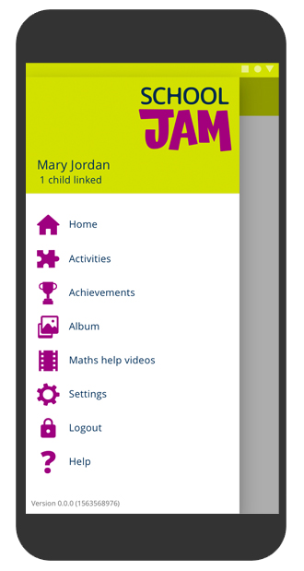


Engaging with your child’s learning through fun activities!

Slide 2


What is School Jam?
It’s an app for parents through which your child’s teacher sends you a weekly maths activity to try with your child, linked to what they are learning in school.
It includes maths help videos especially written for you,
so that you can support your child with maths.
School Jam is fun for you and your child to do together!

Slide 3
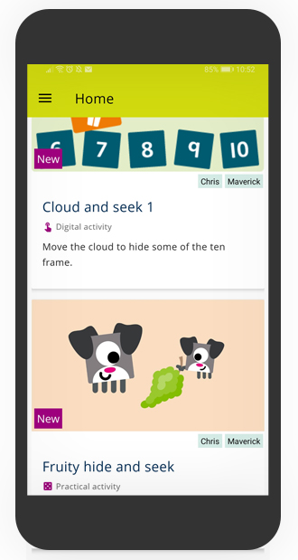
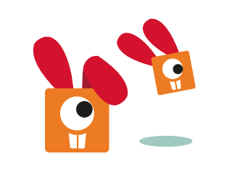
You will receive one activity per week.
All of the short, fun activities are designed for you and your child to do together.

Slide 4
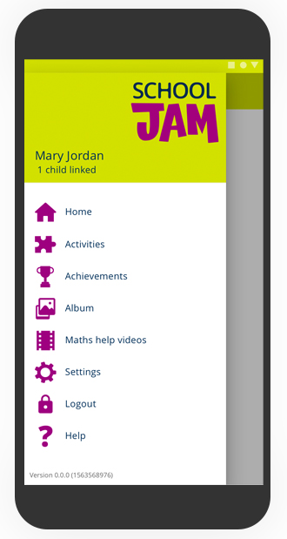
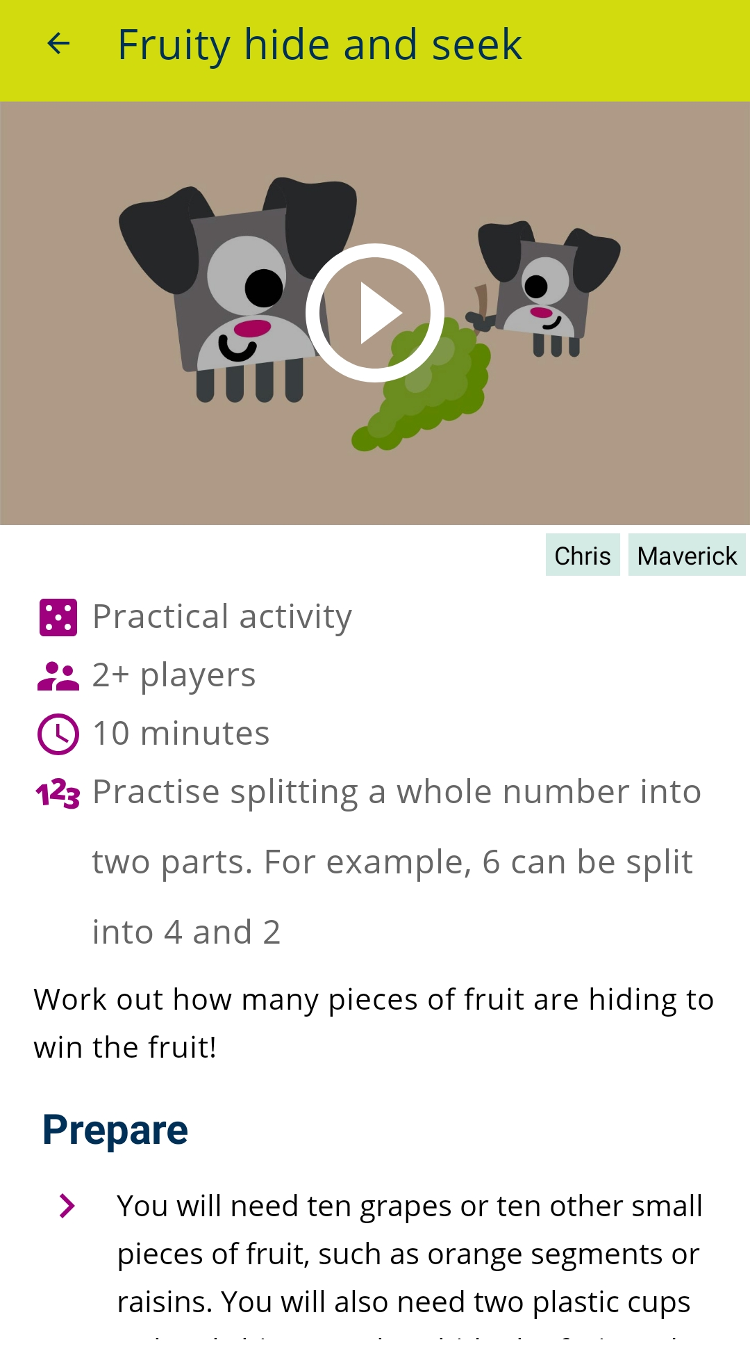
Activities are either practical …
Practical activities have either a fun demo video or clear images to help explain how to do the activity.
Activities might require you to gather simple items from around the home, such as paper or toys.

Slide 5
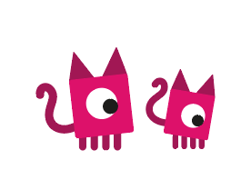
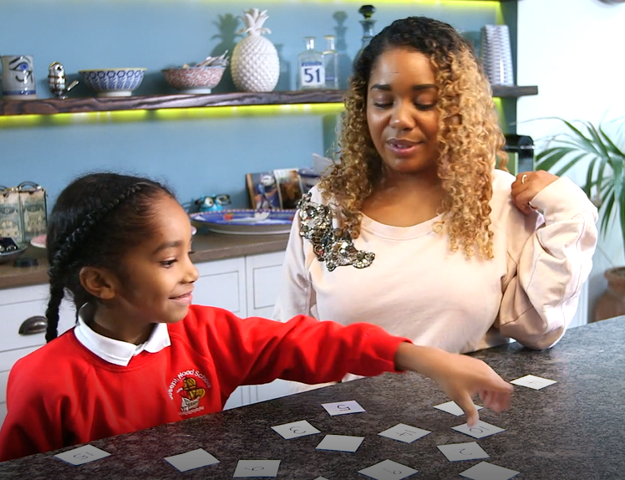
All practical activities have a ‘take it further’ element if you want to give your children more of a challenge.
You can use the School Jam app to tell your child’s teacher when you’ve done the activity.

Slide 6
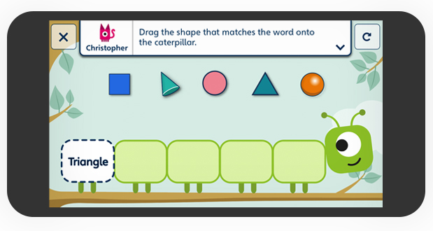
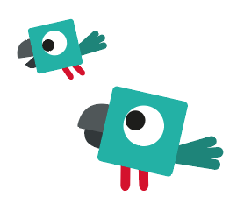
… or digital.
In this example, you work together to match the shapes to the words on the caterpillar.

Slide 7
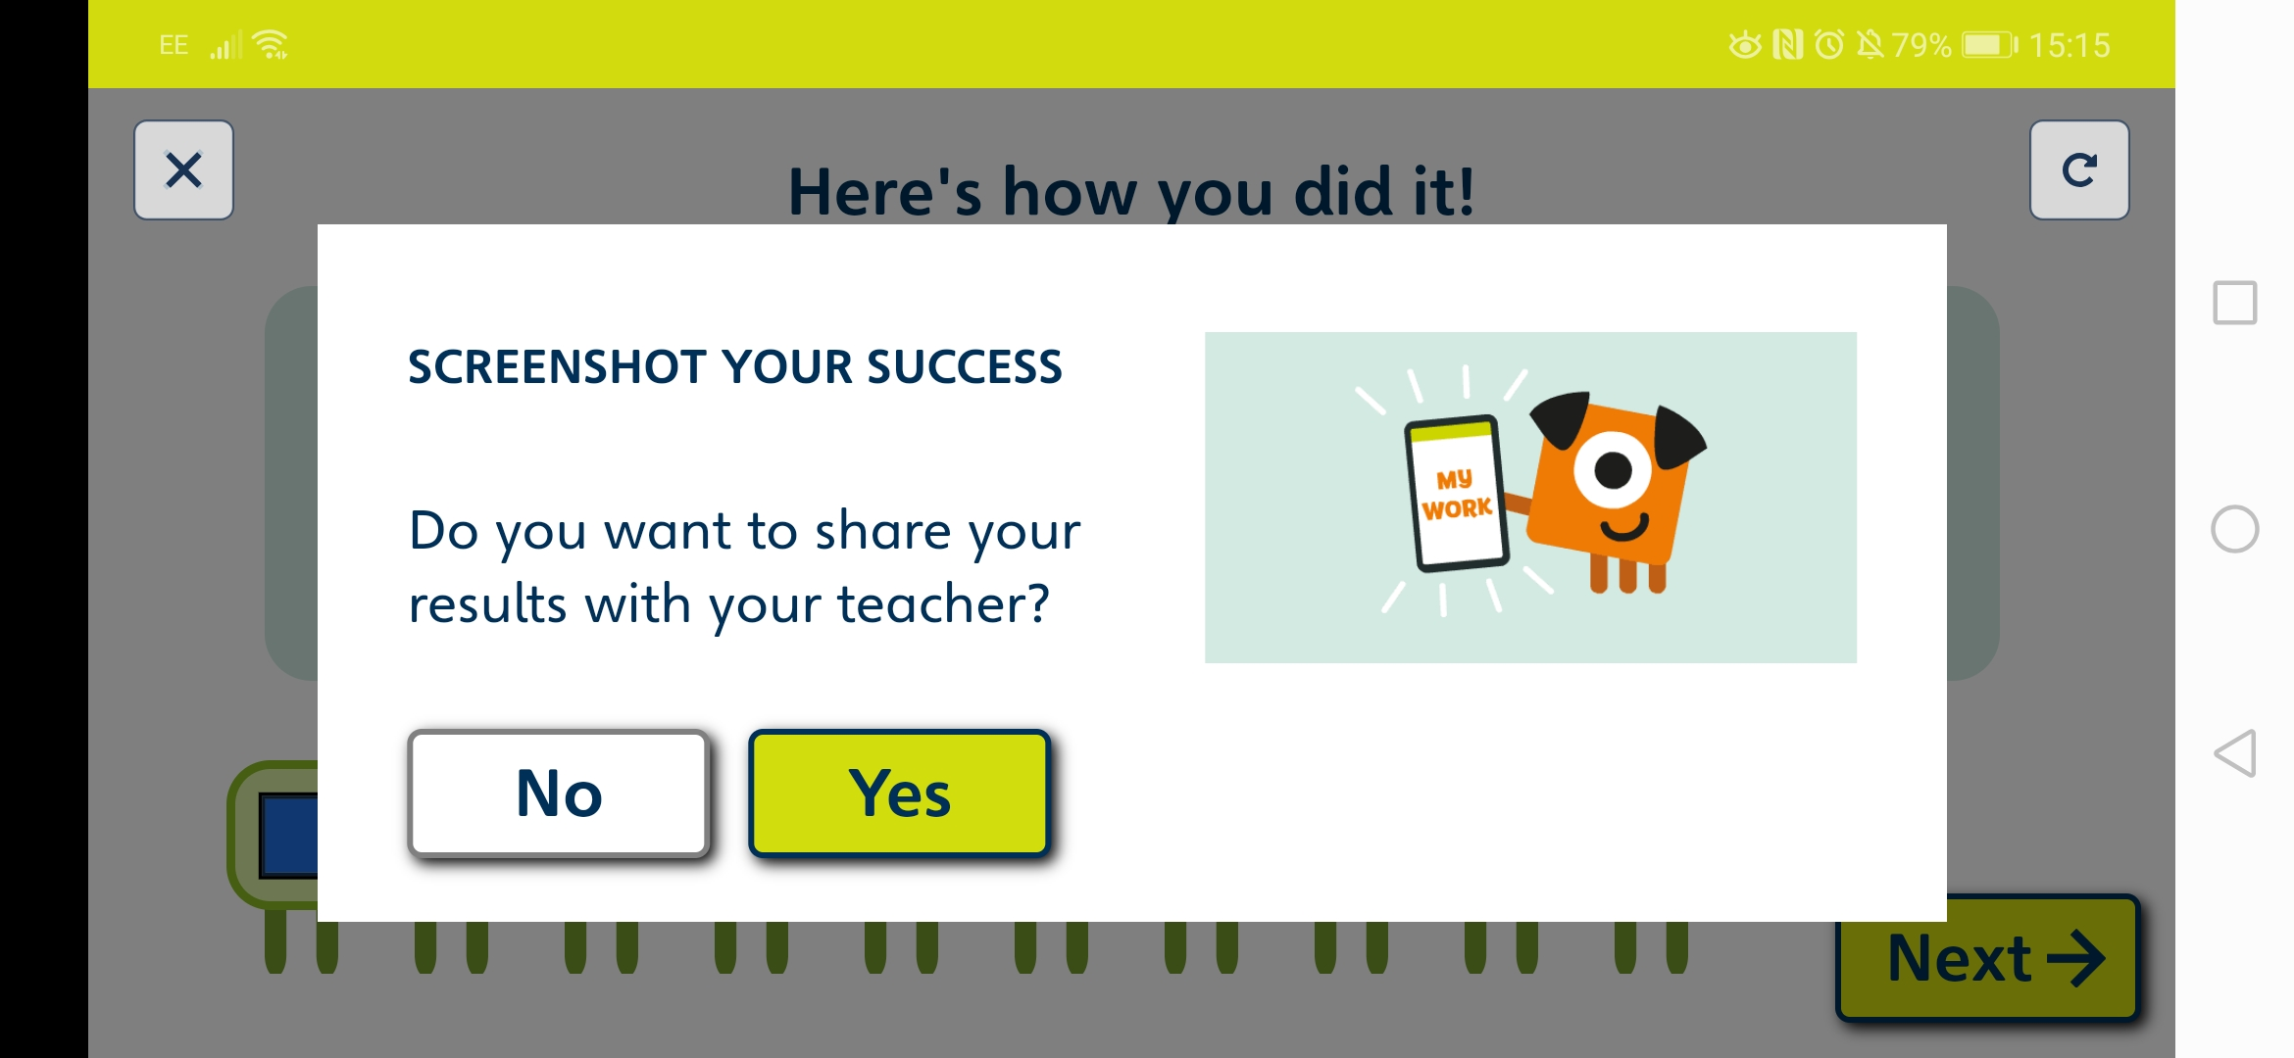
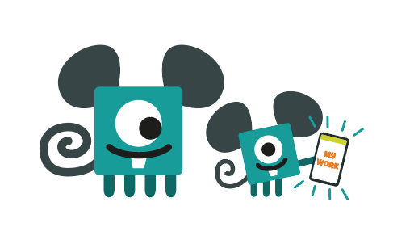
You can send a screenshot of your work to the teacher when you’ve completed the activity.
Your teacher might use these as a lesson starter, or to prompt a maths discussion in class.

Slide 8
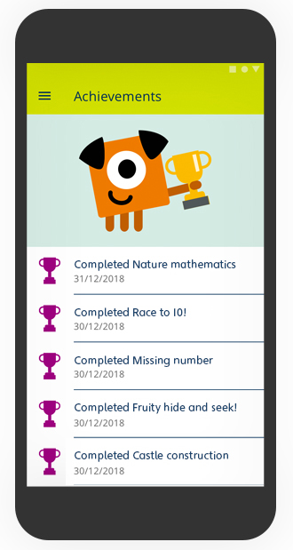
Celebrate your achievements
Collect trophies as you and your child complete the activities.

Slide 9

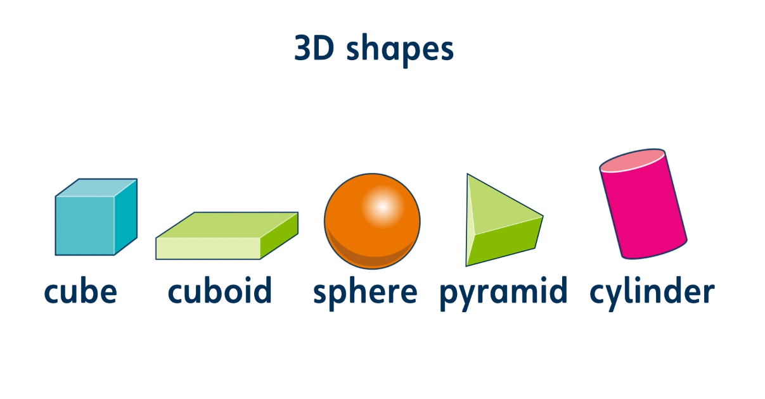

You can also watch maths help videos.
These short videos explain maths methods and support what your child is learning in class.

Slide 10
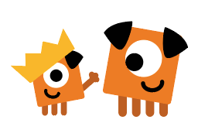
How to get started!
Download School Jam for free from the App store or Google Play.
Look out for your child’s code in their book bag.
Fill in your details and your child code on the app – then get ready to do some fun activities!

