Slide 1
Meet The Teacher
Year 2 2023-24

Slide 2
Classes and Teachers
Indigo
Mrs Lennon
supported by Mrs Morgan
and
Mrs Patrick
Violet
Mrs Wifa
supported by Miss Fernandes
and
Mrs Patrick

Slide 3
Timetable

Slide 7
Reading
Your child will be introduced to Accelerated reader. This is a website used to assist students with reading skills. They will be assessed and assigned to a reading level. Each time they finish reading a book, they take a test based on the text read before moving onto a book of their choice.
The BEST thing you can do to support your child’s reading AND writing progress is to hear them read each night before they go to bed.

Slide 8
Online Safety
This is more important than ever as children are becoming more computer literate by the minute. We will be teaching children to:
Search online safely
Use Purple Mash to share work with their teacher and peers, and finding out what should not be shared online
Send and receive e-mails through Purple Mash and Natterhub
Understand what a digital footprint or trail is and the steps that can be taken to keep personal data and hardware secure.
Please ensure any device your child has access to has parental controls activated and your child
DOES NOT have direct, unsupervised access to the internet, including YouTube.

Slide 9
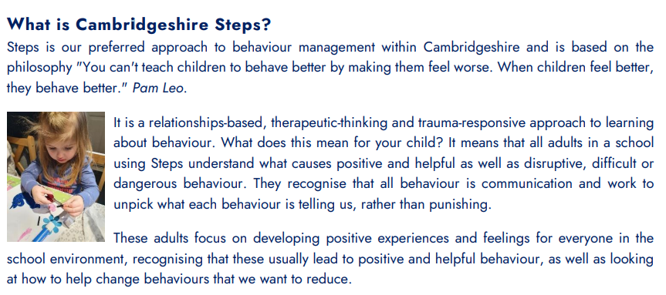
Our Behaviour Approach

Slide 10
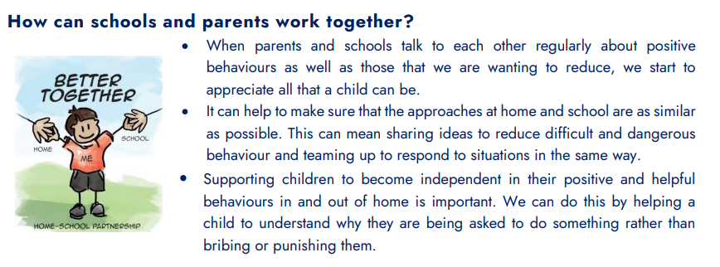

Slide 11
Feedback – a slightly different approach
At Monkfield Park, we recognise the importance of feedback as a vital part of the teaching and learning cycle, and aim to maximise the effectiveness of its use in practise. In every lesson, teachers are giving children continuous, verbal feedback ‘in the moment’ to further their learning. We are mindful of the growing body of research surrounding effective feedback as well as research from cognitive science regarding the fragility of new learning.
Our aim is to maximise the effectiveness of feedback in our practice. As a result, books may look a little different when you come to parent consultation evenings later in the term.

Slide 12
After each lesson, the teacher will look through the children’s books to evaluate learning based on what went well and what still needs work.
The teacher sorts the books into 3 piles:
Children who did not grasp the learning objective or have misconception,
Those who showed solid understanding,
Those who did particularly well or exceeded the objective.
The teacher ticks each piece of work to show it has been checked.
The following codes will be included in the children’s book to indicate their focus prior to the input for the next lesson:
PS Praise and share
T Teacher support group
TA Teaching assistant group
C Challenge
SPAG Spelling and grammar errors
HW Handwriting and presentation
Where the teacher feels any parts of a piece of work should be shared as a good example they will ‘star’ the relevant parts.

Slide 13
Thank you for attending!
Are there any questions?
Notes:
All - We look forward to getting to know you and your children and working with you to make sure that they achieve as much as they can individually and enjoy their time in Year 2.

