Slide 1
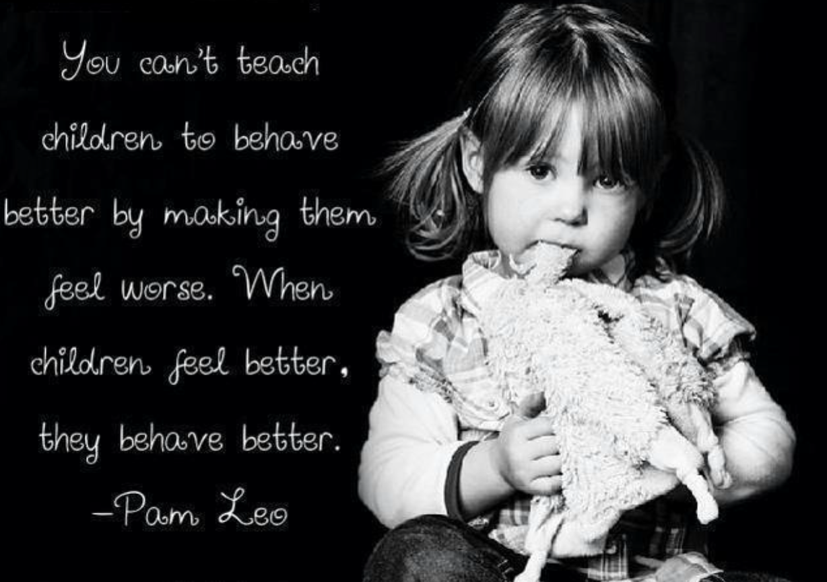
What is Cambridgeshire Therapeutic Thinking?
Therapeutic Thinking is a relationships-based, therapeutic-thinking and trauma-responsive approach to learning about behaviour. It is the preferred approach within Cambridgeshire and is based on the following philosophy:

Slide 2
What does Cambridgeshire Therapeutic Thinking look like at Monkfield Park?
Ethos: We have shared values and beliefs as to the importance of the Therapeutic Thinking approach. It uses a restorative approach – teachers and children work together to rebuild relationships and repair any harm done.
Training: All staff have been trained in Therapeutic Thinking. We know how to promote positive and helpful behaviour and manage disruptive, difficult and dangerous behaviour. Staff understand what a child’s behaviour might be communicating to them.
Shared approach: We teach and model positive and helpful behaviour. We all have a consistent approach to managing situations and responding to incidents, using the same language and techniques.
Priorities: We focus on preventing and de-escalating incidents, rather than reacting to them.
Consequences: Behaviours will have logical consequences that provide an opportunity for a child to learn how to change a behaviour. Pupils don’t just ‘miss a break’ because they were disruptive in maths, for example. They may need to catch up uncompleted work, but adults will also try to understand why they were being disruptive, but pupils don’t lose their break as a punishment.

Slide 4
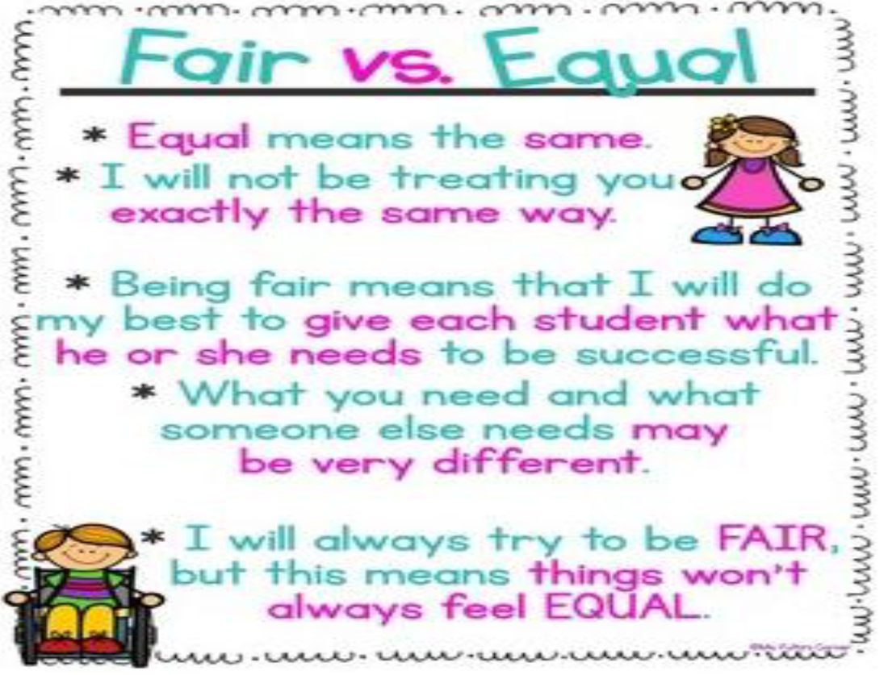

Slide 5
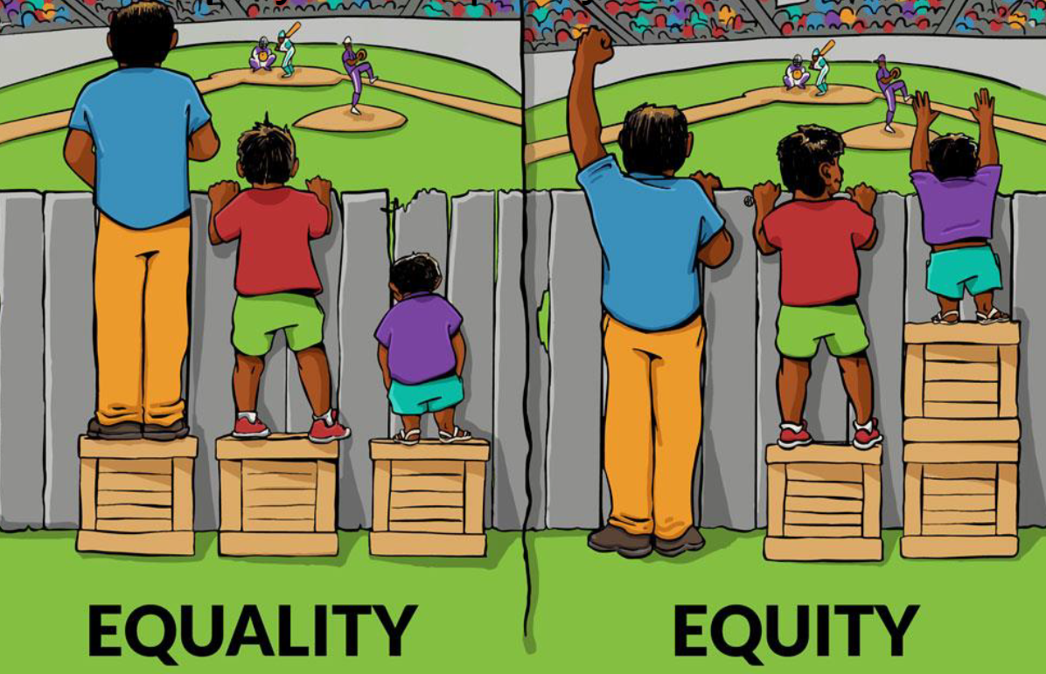

Slide 6
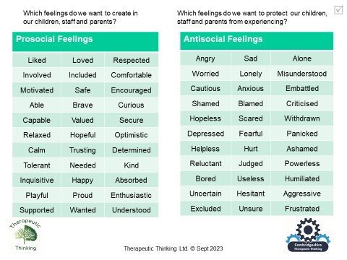

Slide 7
What do consequences look like when inappropriate behaviours occur?
Where children show inappropriate behaviours, it is appropriate and necessary for them to see the consequences to their actions.
There are two types of consequences that should be used, Protective and/or Educational. When carrying out conversations with children about their actions this should be done during their free time (break time and lunchtime).

Slide 8
Protective Consequences
Protective Consequences is a removal of a freedom to manage dangerous behaviour. They could include:
increased staff ratios (increased supervision of an identified child/children)
being escorted in social situations e.g. transition times
differentiated teaching space
limiting access to activity or area of the school
limited access to lunchtime choices

Slide 9
Educational Consequences
Educational consequences is to aid learning, rehearsing, or teaching so the freedom can be returned. In assessing the need for a consequence we will ask the following questions using visual supports:
modelling of activities where the behaviour has occurred
restorative actions
whole class/small group activities on specific topics
educational opportunities e.g. research into the rules of football, reflection time, de-escalation strategies specific to the individual child.

Slide 10
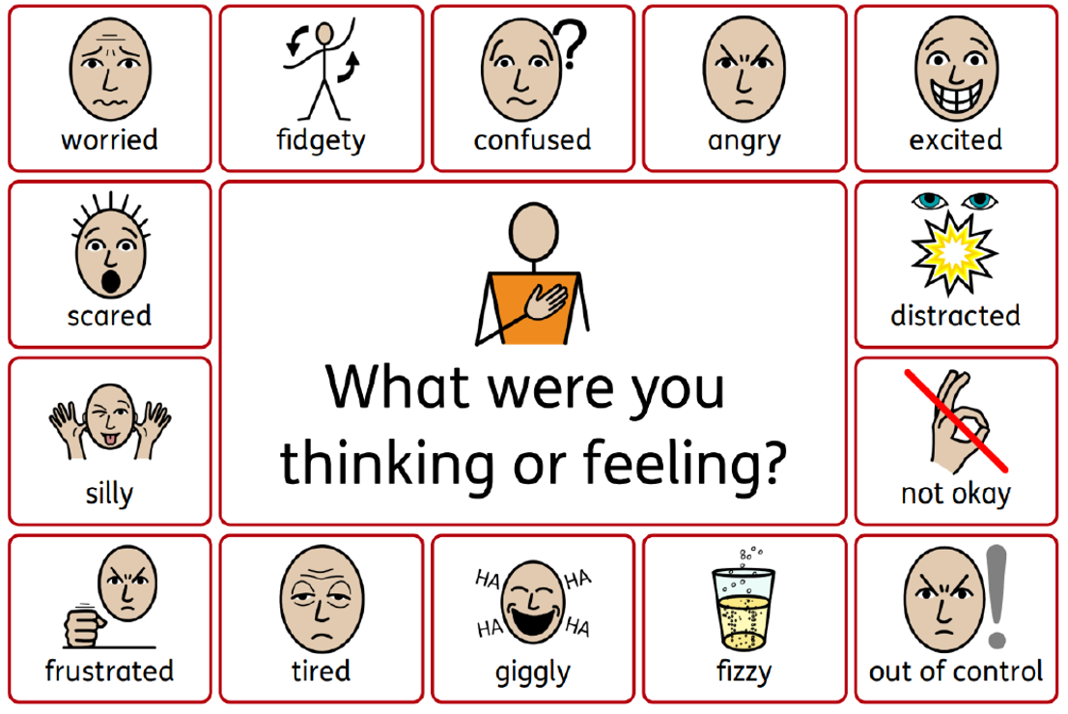
Restorative Questioning
What happened? What were you thinking at the time? What have you thought about since? Who has been affected by what you have done? ... What do you think you need to do to make things right? If the same thing happens again, how could you behave differently?

Slide 11
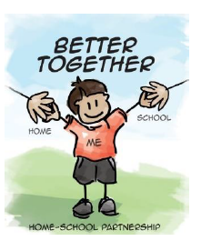
How can schools and parents work together?
Consistency between approaches at home and school are key to success.
Supporting children to become independent in their positive and helpful behaviours in and out of home is important. We can do this by helping a child to understand why they are being asked to do something rather than bribing or punishing them.
Encourage your child to talk about their feelings and your feelings – happy, sad, bored, angry, irritated, or excited. It is ok and normal to feel all these things. Let your child know that it is how we learn to respond to our feelings that is so important.
Encourage your child to stick at something they find difficult: support them with a difficult piece of work, a tricky jigsaw puzzle, losing at a board-game, a long walk, or a challenging sporting activity. This will build up their confidence and promote their positive feelings about themselves.

Slide 12
Some ideas to try at home
Help them calm down when their feelings become too big for them to cope with. All children get upset but at times, these feelings feel too big to manage on their own.
You can help by:
• showing your child you understand what they’re feeling
• letting them know they are safe
• being patient
• helping your child to understand what has happened
• try calming activities such as breathing techniques to help them get rid of frustrations.

