Slide 1
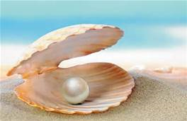
The daily life of a pearldiver
Saeeds life

Slide 2
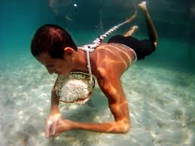
The work of Saeed
SAEED HAD A HARD LIFE AS A PEARL DIVER HE HAD TO MAKE COFFEE FOR THE OARSMEN AND GET FISH.SAEED LEARNED HOW TO DIVE VERY WELL, HIS FATHER HELPED HIM - HE WAS A DIVER TOo.

Slide 3
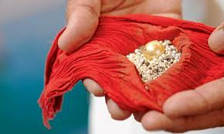
PEARLS
PEARLS WERE VERY PRECIOUS ODJECTS, THEY WRE FOUND IN OYSTERS BY PEARL DIVERS.PEARLS WERE VERY SHINY AND WERE A LOT OF MONEY WORTH.

Slide 4
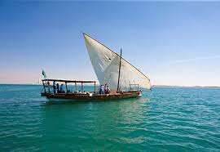
sambuk
SAMBUKS ARE GREAT BIG NARROW SHIPS. THEY ARE VERY STRONG SO THEY CAN CARRY A LOT OF PEOPLE.THEY HAVE A GREAT BIG TRIANGLE SAIL.

Slide 5
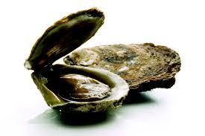
OYSTERS
OYSTERS ARE VERY SALTY SEA ANIMALS. THEY CONTAIN A PEARL RARELY MOSTLY A LITTLE FISH. NOT MANY PEOPLE LIKE THEM BECAUSE THEy’re SO SALTY.

Slide 6
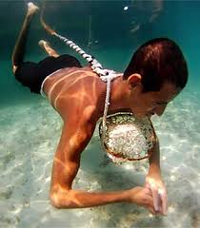
WHAT THEY WORE
PEARL DIVERS WORE A STONE ROUND THEir BACK, A GOAT HORN ON THEir NOSE AND A ROPE THAT THEY HELD ONto. WITH THEM, THEY CARRIED A BASKET WHERE THEY PUT THE OYSTER IN.

Slide 7
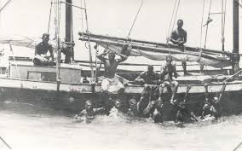
OARSMEN
OARMEN WERE THE PEOPLE THAT CONTROLLED THE BOAT WITH OARS. Their ORDERS WERE DEMANDED BY THE NAKHUDA. OARSMEN WEREN’T PAYED much.

Slide 8
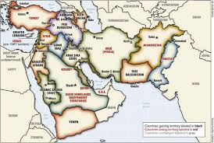
Where to do it
PEARL DIVING TOOK PLACE IN THE MIDDLE EAST. IT WAS SET ON THE COAST OF A COUNTRY IN THE MIDDLE EAST (bahrain)

Slide 9
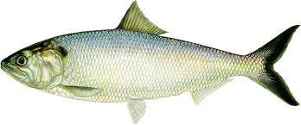
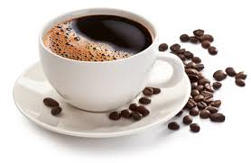
WHAT THEY ATE
PEOPLE ON THE BOAT ATE FISH AND DRANK COFFEE.

Slide 10
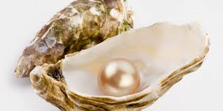
THANKS FOR WATCHING

