Slide 1

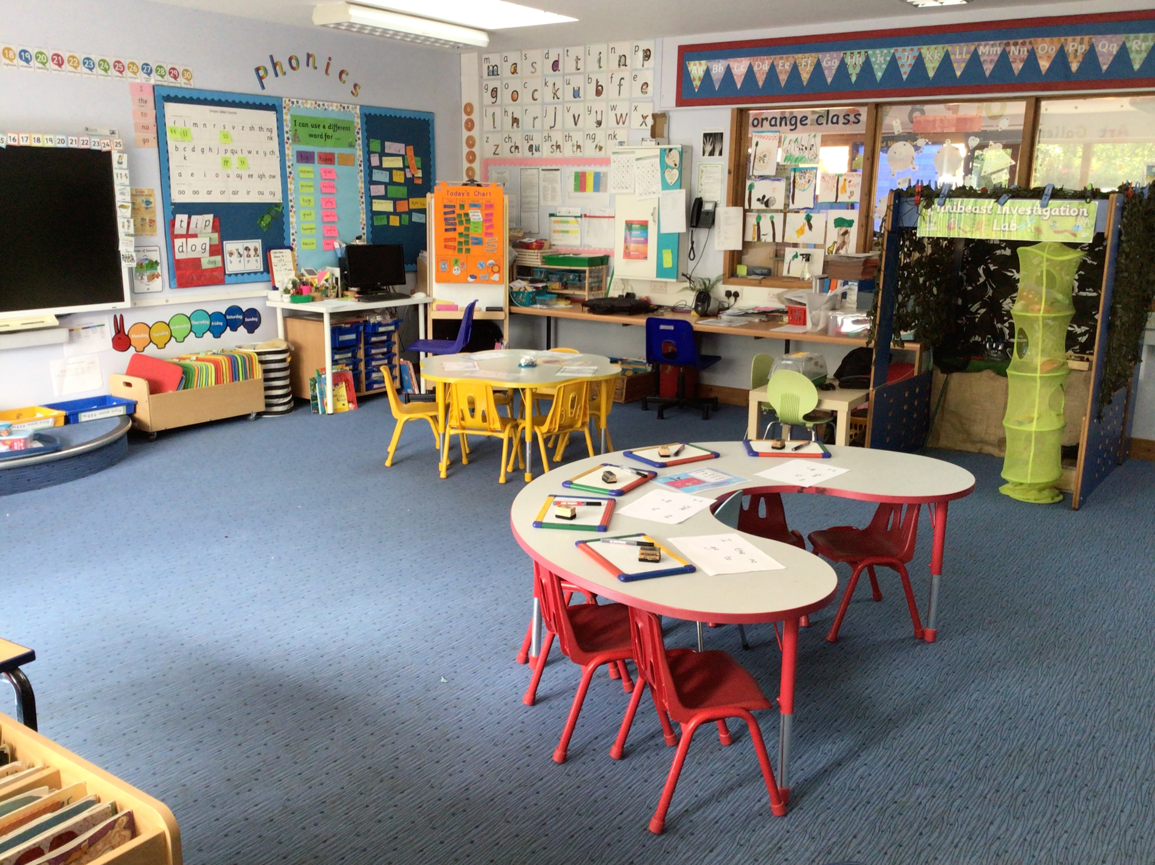

STARTING RECEPTION: A GUIDE FOR PARENTS
Supporting your child's first steps into school life
For more information, visit-
https://startingreception.co.uk
https://beststartinlife.gov.uk/preparing-for-school/?es_c=7215A43D5BA4A0596E26ACC2E0A29BB2&es_cl=F687EFB7AA384BF85D92A0BA9151DEBB&es_id=ph7%c2%a386

Slide 2

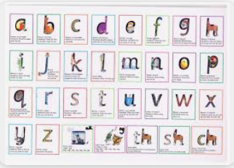
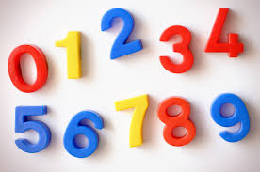
What a day looks like in Reception
Start school at 8.50 and all children take part in Busy Fingers
Handwriting activity
Daily phonics lesson
Playtime
Snack and milk
Maths lesson
Lunchtime
Topic lesson
Story and songs
Home time at 3.30
Busy Finger activities are completed to assist with developing their fine motor skills
We use Read Write Inc to deliver phonics lessons
White Rose Maths is followed to deliver maths lessons
Topics are based on the children’s interests
Children have access to Busy Learning throughout the day – this is where they make independent choices about the activity they would like to do

Slide 3

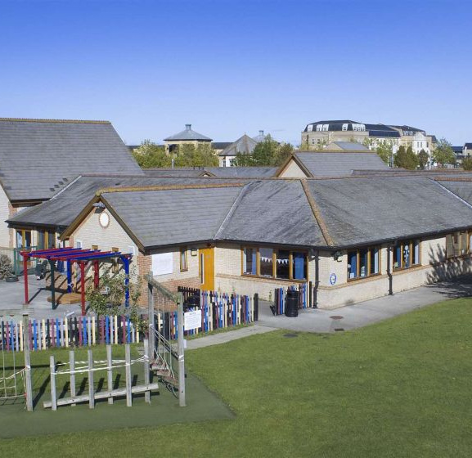
WELCOME TO THE JOURNEY
A Big Milestone
Starting primary school is an exciting time for both you and your child. It marks the beginning of their formal education in England through the Early Years Foundation Stage (EYFS).
Why Focus on Readiness?
'School readiness' isn't about reading or writing yet! It's about giving your child the confidence and independence to thrive in a classroom environment. When a child can manage their behaviour and be independent, they feel happier and more settled.

Slide 4
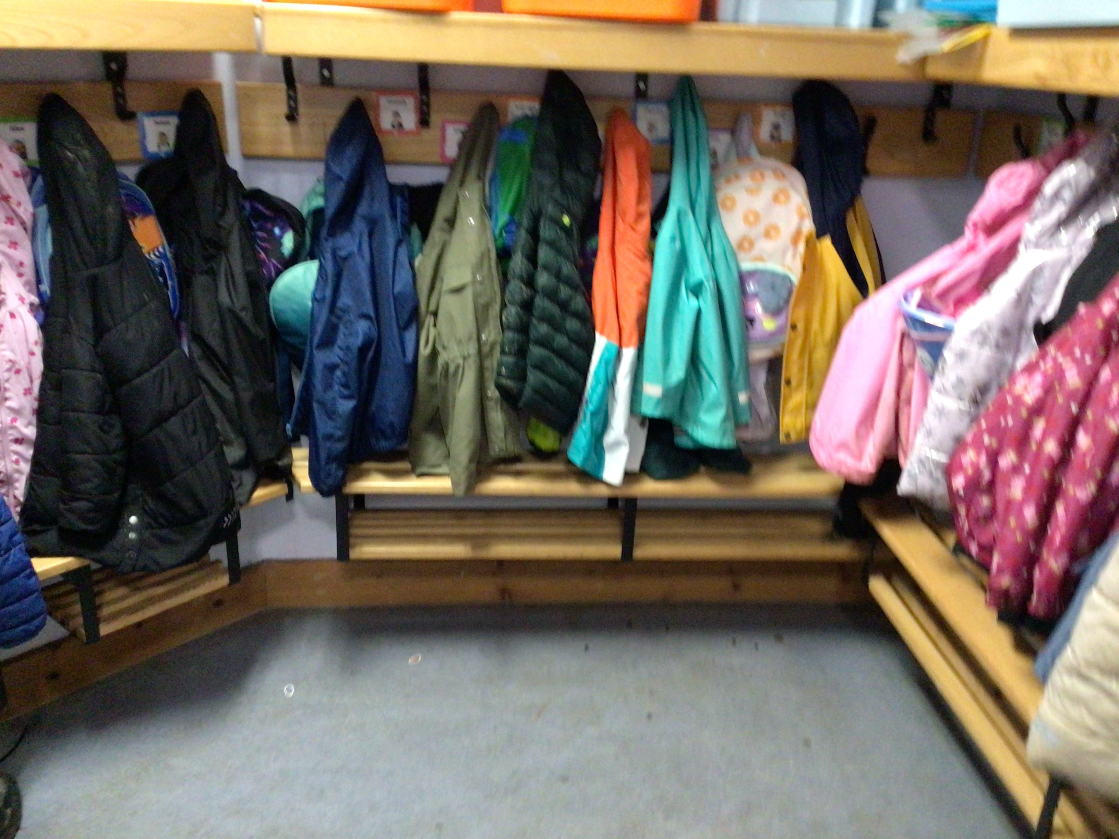
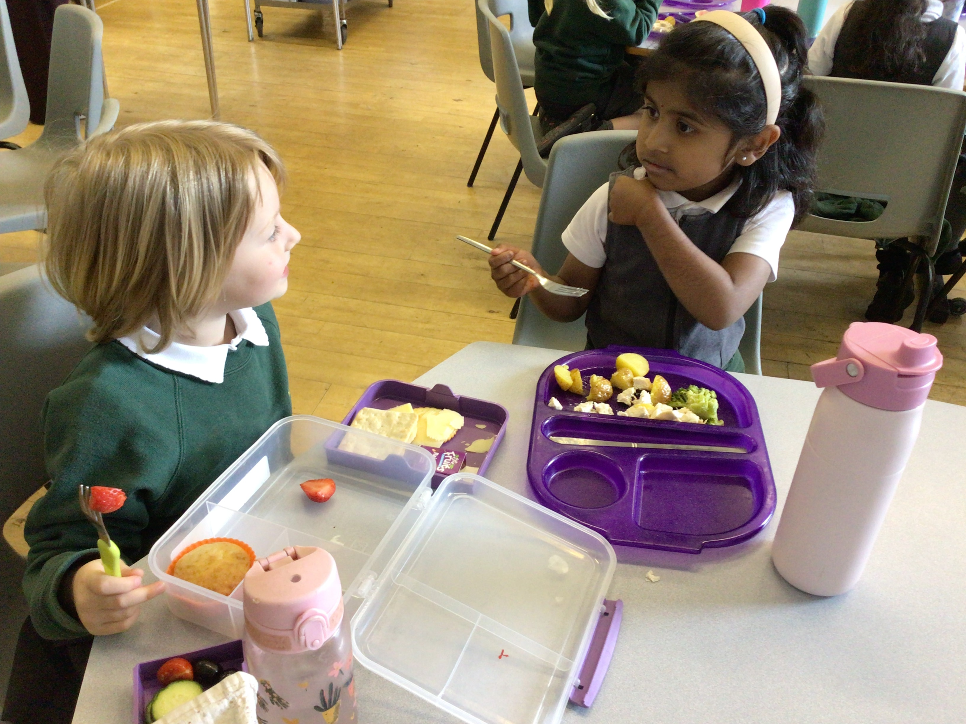
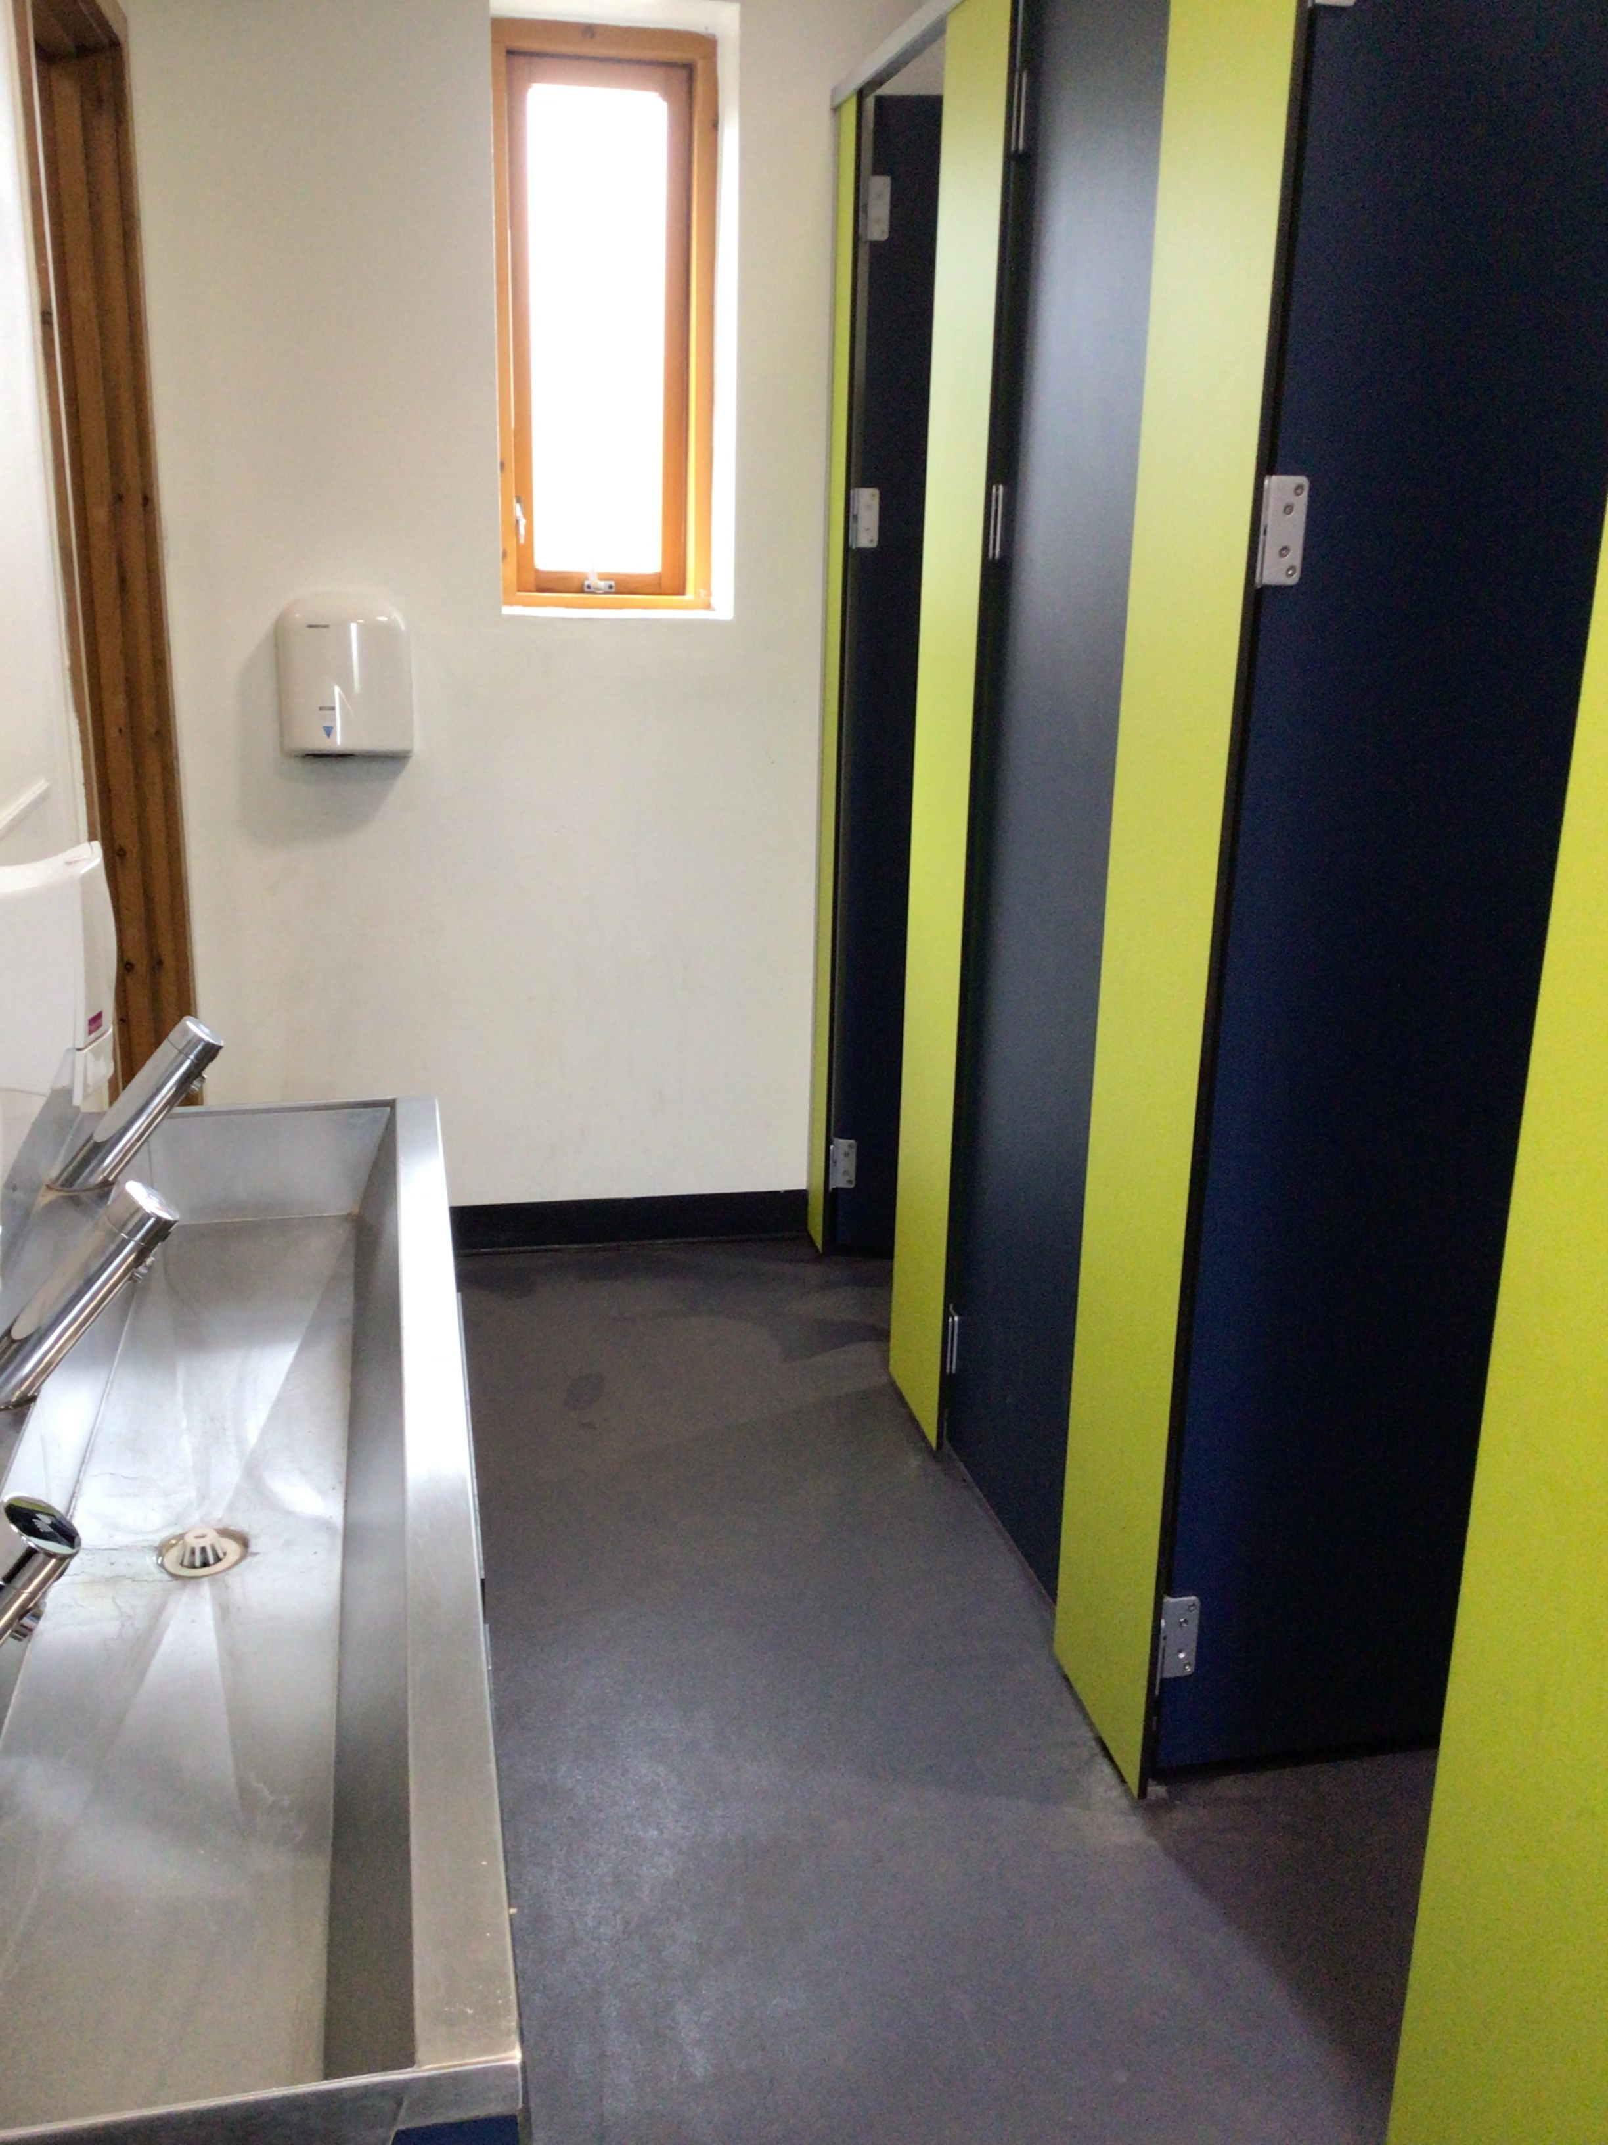
EVERYDAY INDEPENDENCE
1
2
3
The Toilet
Encourage your child to use the toilet and wash hands thoroughly.
Dressing
Practice putting on and taking off coats. This helps during busy break times!
Meal Times
Practice using a knife and fork. It builds motor skills, independence and confidence.

Slide 5
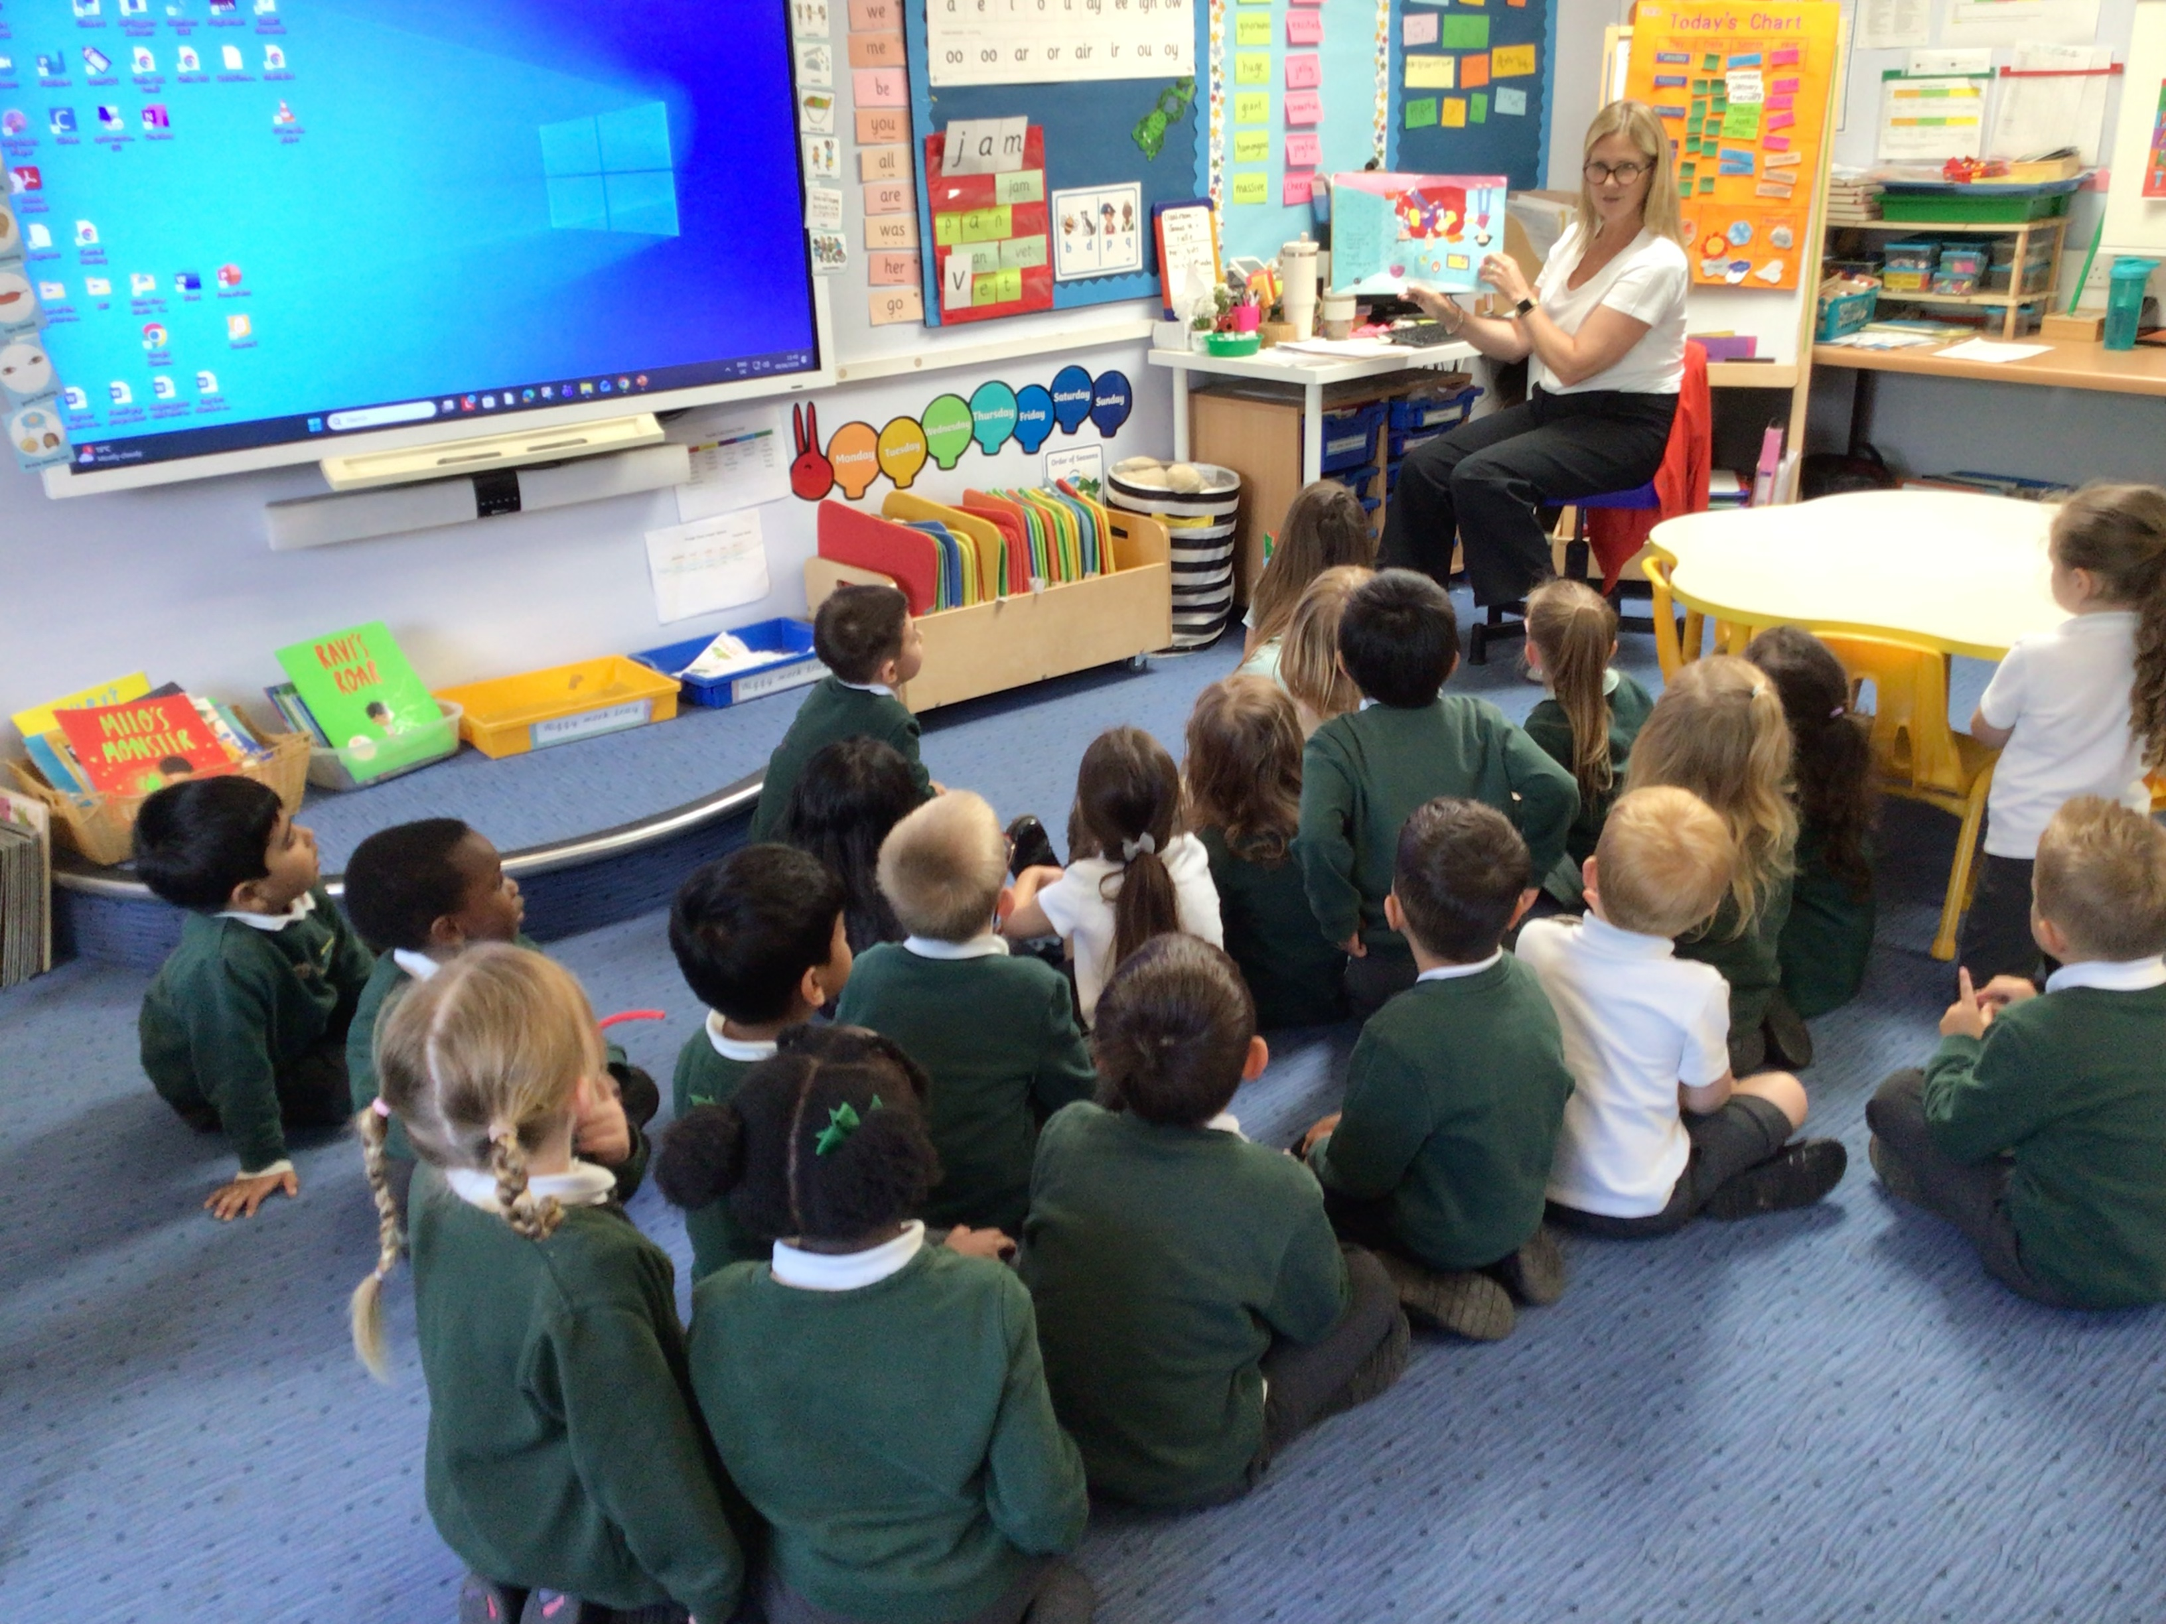
LISTENING AND FOLLOWING INSTRUCTIONS
The Power of Listening
In a busy Reception class, children need to follow simple instructions like 'Sit on the carpet' or 'Line up for lunch'.
How to Support This
Try giving two-step instructions at home (e.g., 'Put your shoes away, then find your teddy').
Read stories together and ask them what happened next to build focus.
Play games like 'Simon Says' to make following directions fun and engaging.

Slide 6

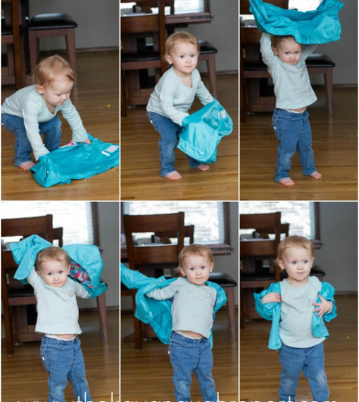
THINKING ABOUT READINESS
Which ‘self-care’ skill do you think will be the most helpful for your child to master before their first day, and why?

Slide 7
THINKING ABOUT READINESS
✅​
You might have said...
Independence with the toilet reduces anxiety for the child.
Putting on a coat allows them to get outside quickly to play with friends.
Using cutlery makes lunchtimes less stressful and more social.
Following instructions helps them feel part of the classroom community.

Slide 8
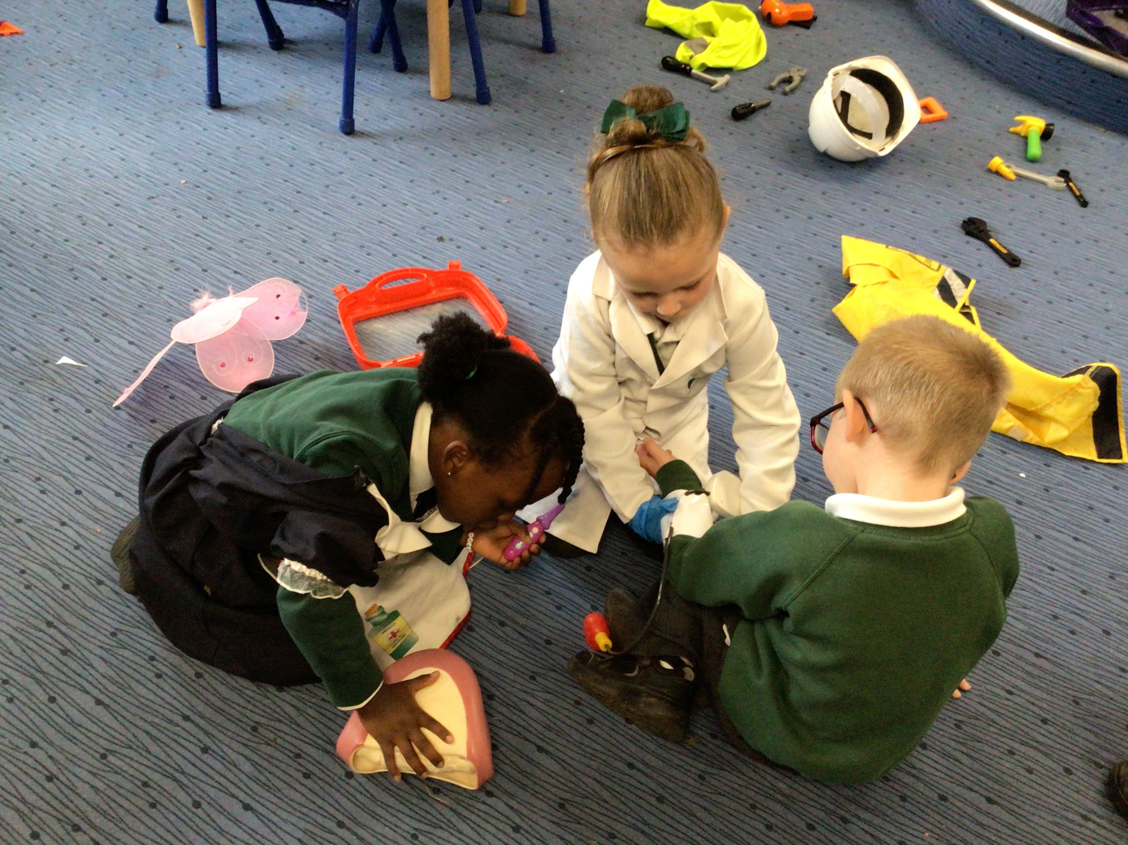
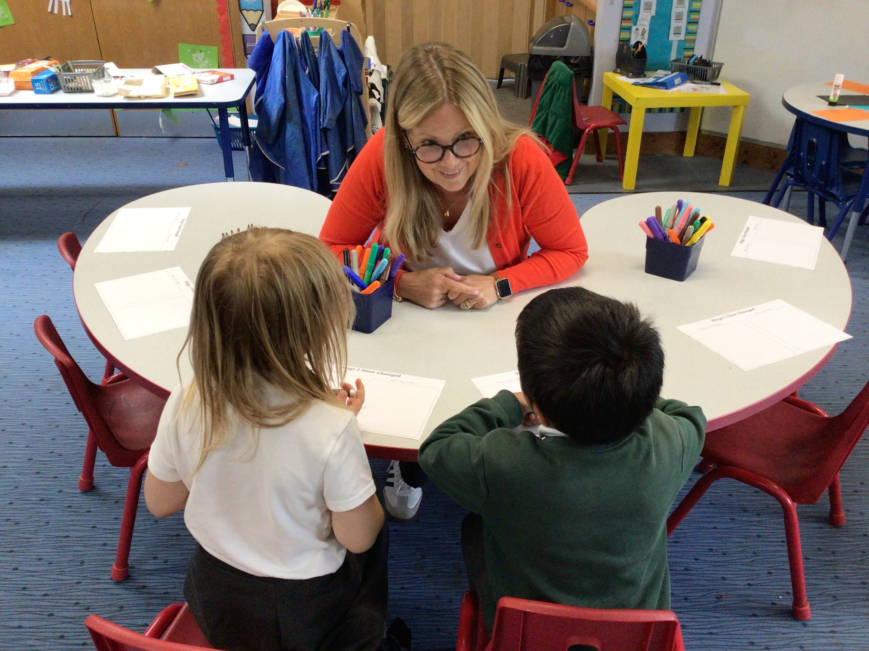
COMMUNICATION AND LANGUAGE
Encourage your child to express their needs clearly, such as asking for a drink or saying if they feel unwell. Model speaking in sentences and ask them to repeat the sentence back to you. For example, if they ask for 'drink', you could say, "Please can I have a drink."
Sharing through talk helps teachers understand your child's personality and how best to support their learning.

Slide 9
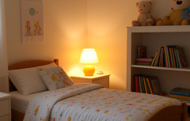
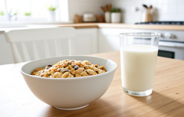
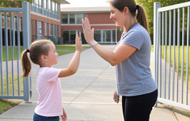
THE DAILY ROUTINE
Early Nights
Establish a consistent bedtime so your child is well-rested and ready to learn.
Morning Calm
Leave plenty of time for breakfast and getting dressed to avoid a stressful rush.
A Happy Goodbye
Keep drop-offs brief and positive. A smile and a wave help them feel secure.

Slide 10

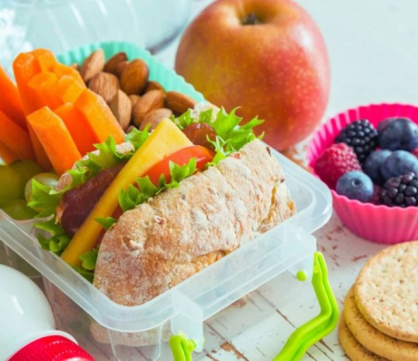
HOME PRACTICE TASK
This week, try a 'school picnic' at home! Let your child practice opening their own lunchbox, unwrapping a sandwich, and using their water bottle without help.

Slide 11
KEY TERMS FOR PARENTS
1.
EYFS
The curriculum for children aged 0 to 5.
2.
Transitions
The process of moving from home to school settings.
3.
Fine Motor
Small movements using fingers, like cutlery.

Slide 12
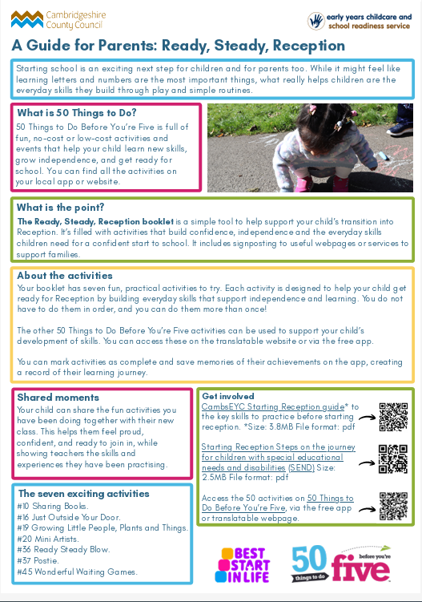

Slide 13
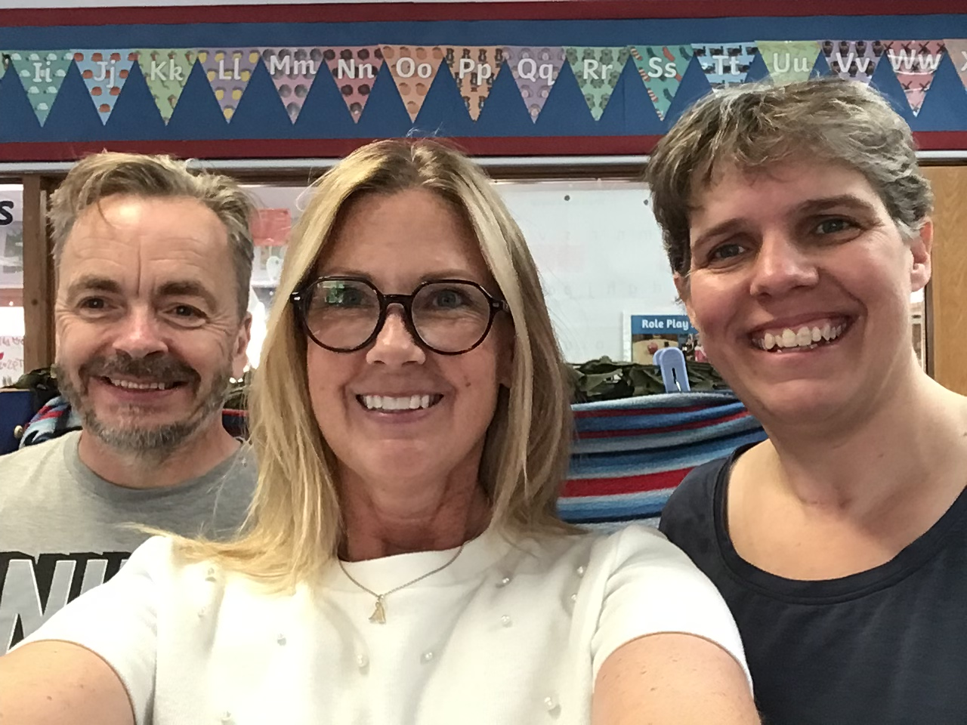
SUMMARY: YOU'VE GOT THIS!
Building a Partnership
Remember, we are here to support you. We don't expect children to be perfect—we just want them to be ready to try!
Key Takeaways
Focus on independence (toilets, coats, cutlery).
Build listening skills through play.
Keep routines positive and consistent.
We can't wait to see your child in Reception!

